Slide 1
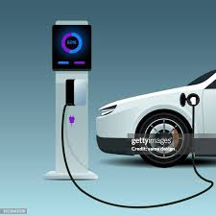
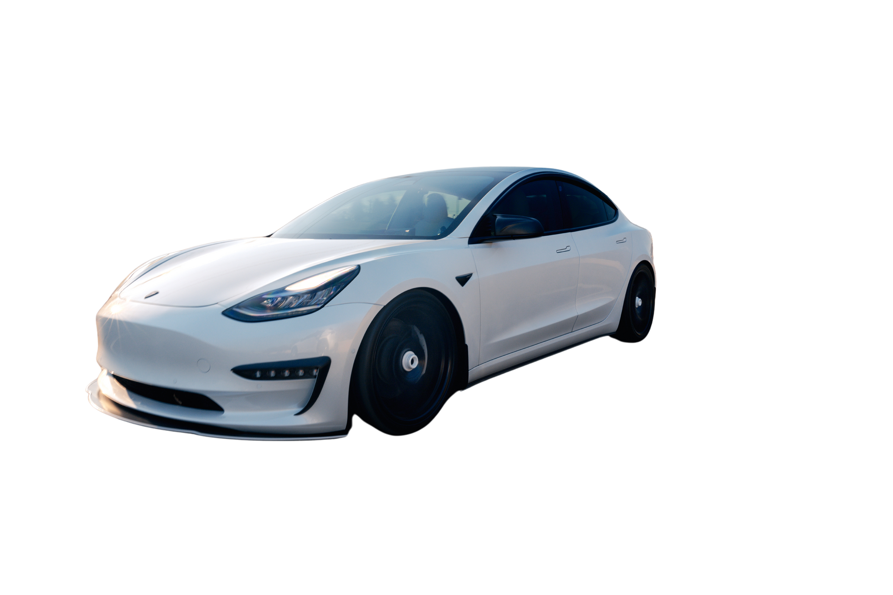
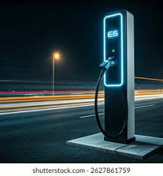


CAPSTONE PROJECT: WARSAW EV CHARGING ANALYTICS

Slide 2
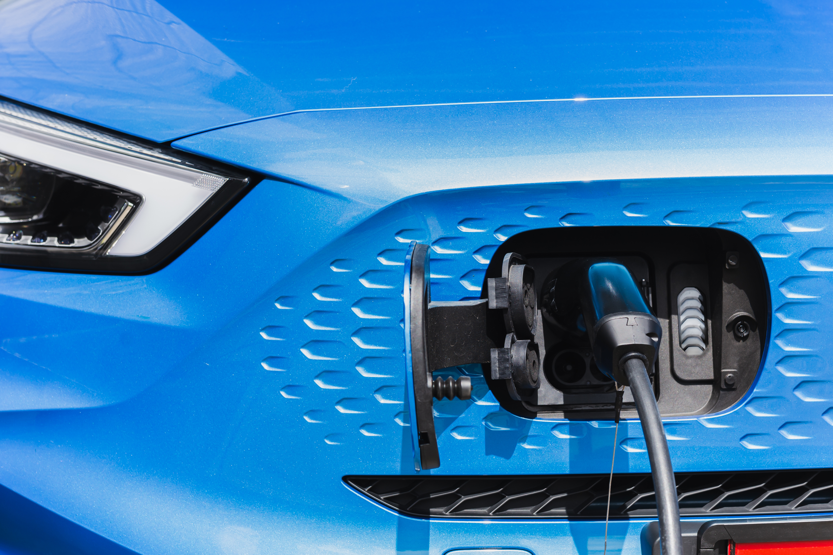
INTRODUCTION
WHAT ARE ELECTRIC VEHICLES?
An Electric Vehicle (EV) is a vehicle that runs on electric power instead of petrol or diesel.
It uses a battery pack to store electricity and an electric motor to move the vehicle.
HISTORICAL ROOTS
MODERN IMPORTANCE
Electric vehicles actually came before petrol cars — early EV models were developed in the 1830s–1900s, even before mass production of gasoline cars by Henry Ford.
They declined after cheap petrol cars like the Ford Model T became popular, but revived strongly in the 21st century due to climate concerns and battery advancements.
Electric vehicles are crucial today for reducing carbon emissions and urban air pollution, helping countries meet climate targets and move toward clean energy.
They also reduce fuel dependency, lower running costs, and support the growth of smart charging infrastructure and green technology industries.

Slide 3

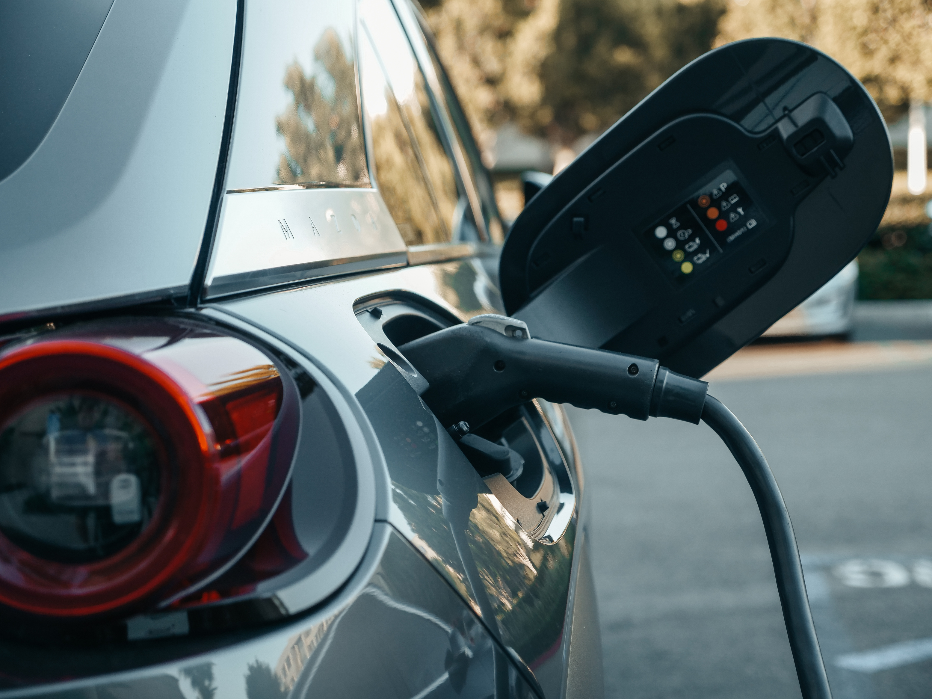
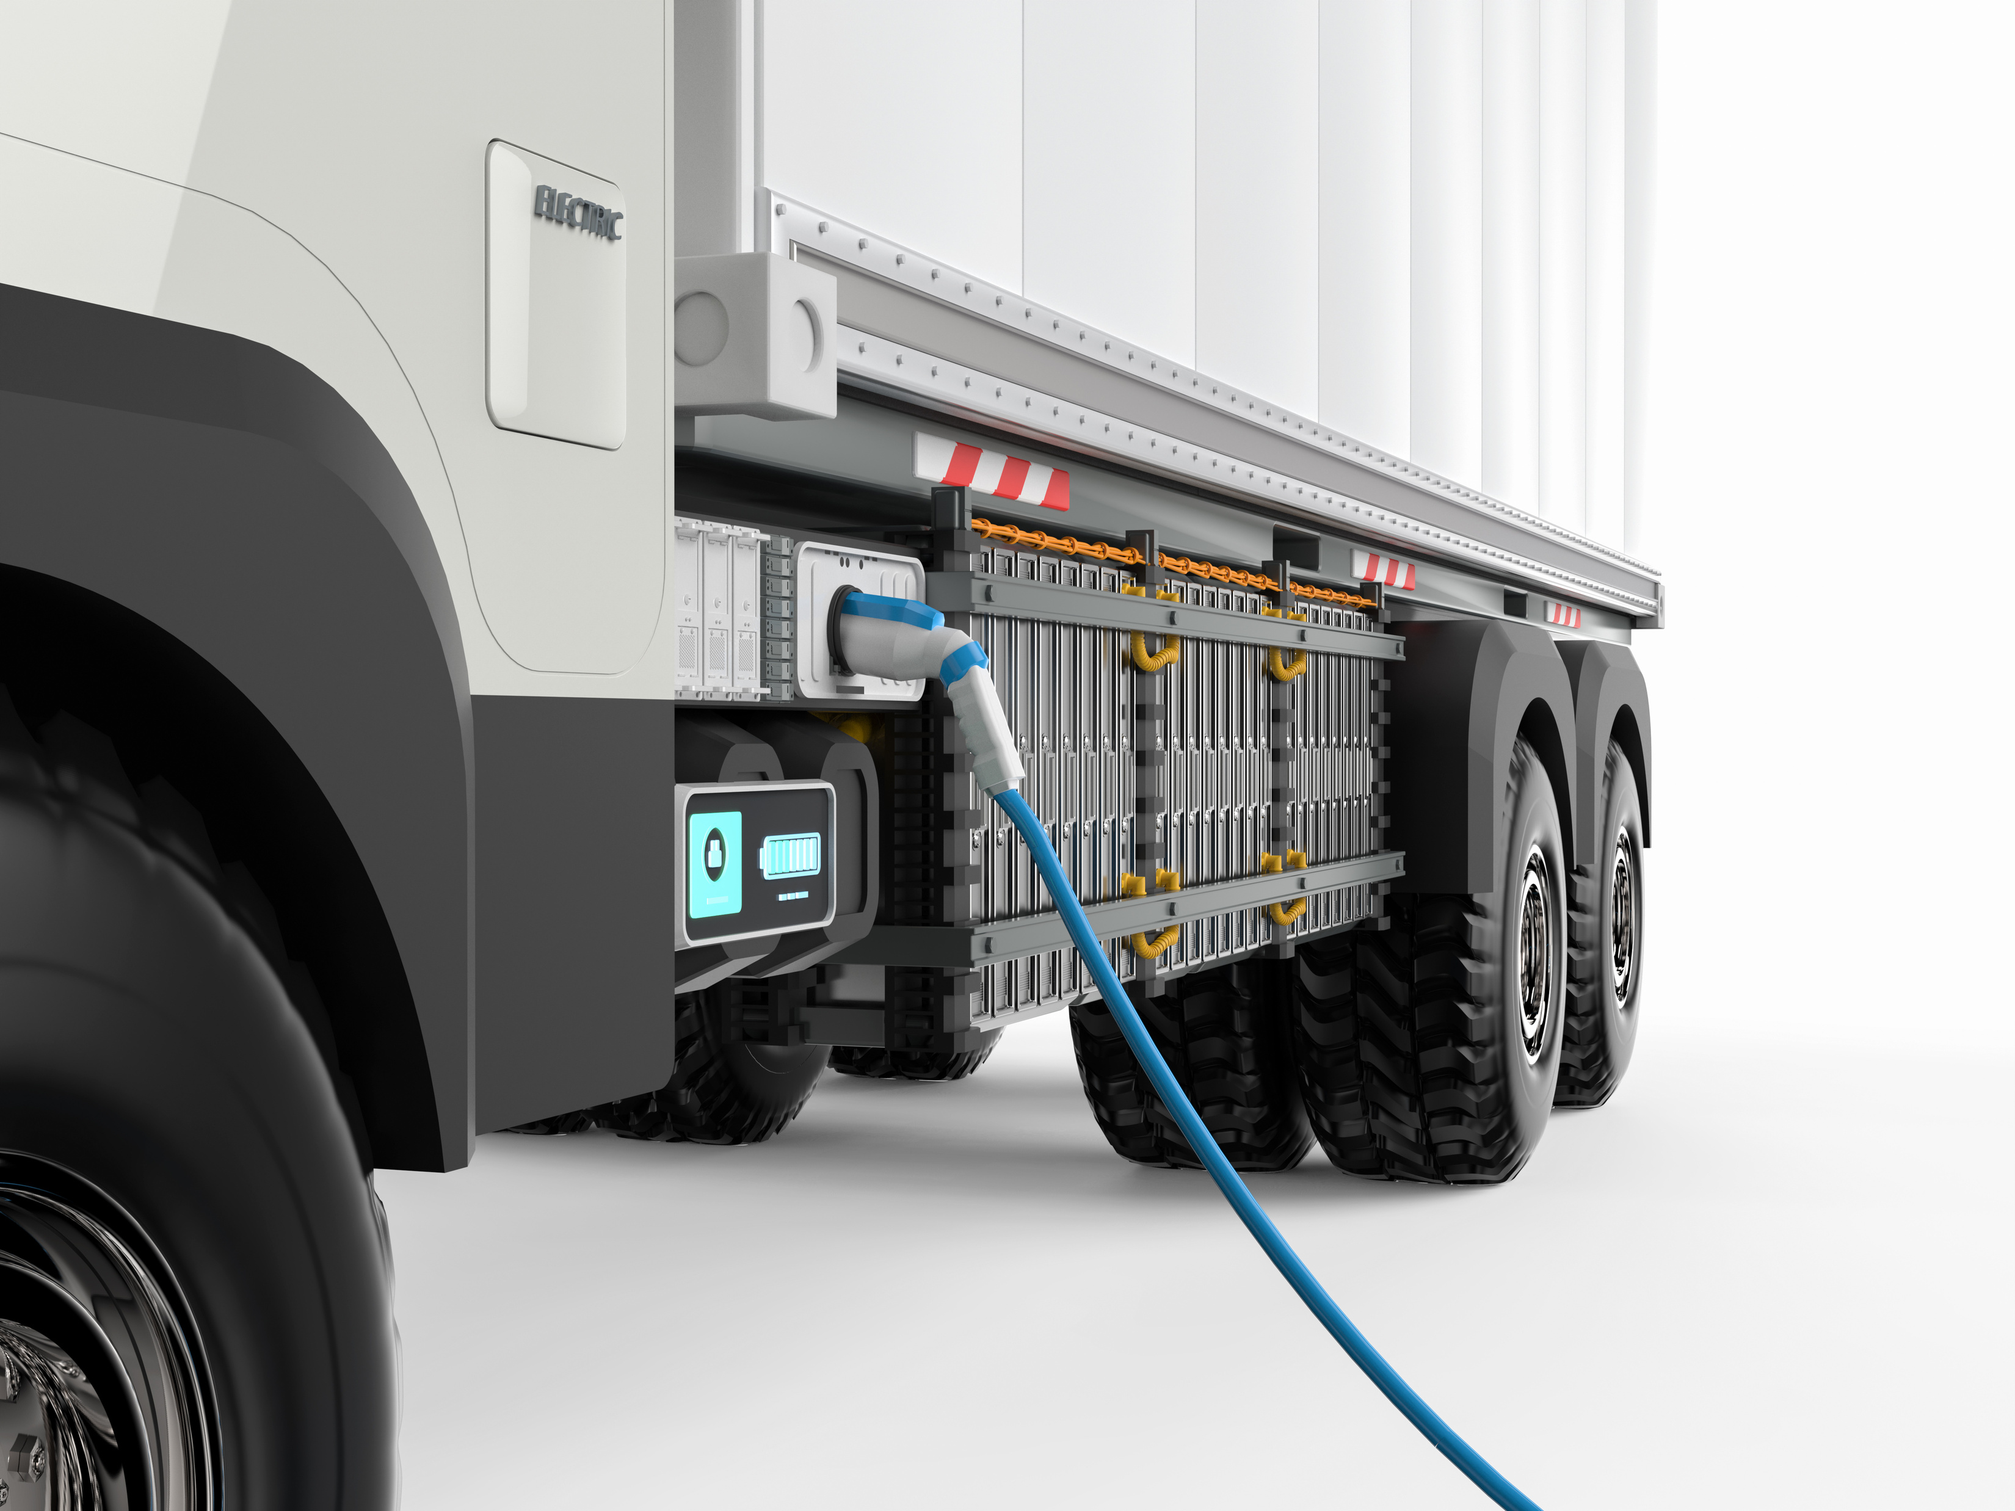
TYPES OF ELECTRIC VEHICLES
UNDERSTANDING EV CATEGORIES
BATTERY ELECTRIC VEHICLES
PLUG-IN HYBRID ELECTRIC VEHICLES
HYBRID ELECTRIC VEHICLES

Slide 4

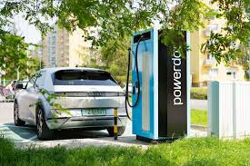

Slide 5
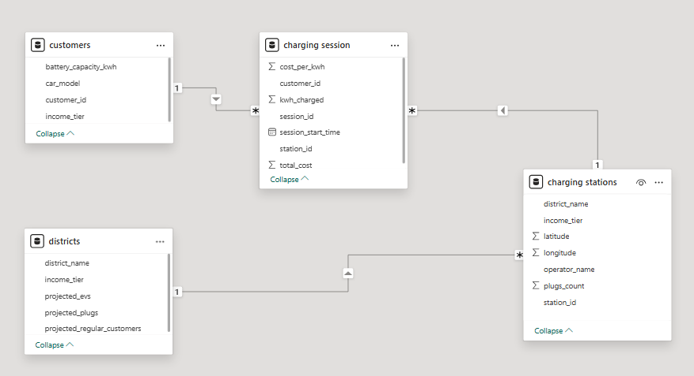
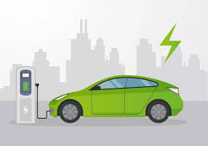
Data Modelling

Slide 6

🚀 Part 1: SQL Analysis (14 Questions)
I used Python code to import csv file into MYSQL.
here is the code gihub link
ENVIRONMENTALLY FRIENDLY
LOWER COSTS
QUIETER OPERATION

Slide 7
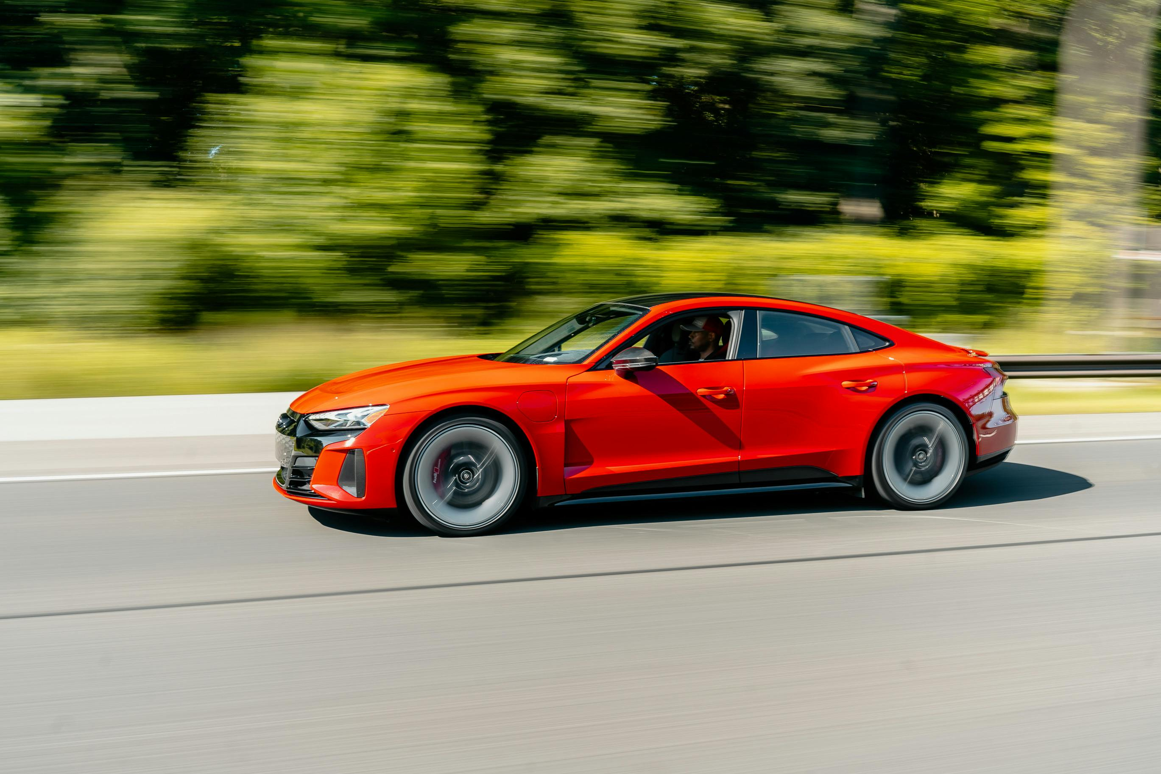
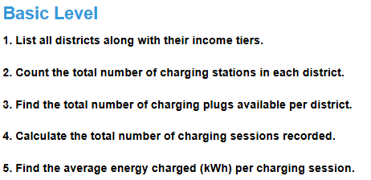

HIGH BATTERY COSTS
LIMITED INFRASTRUCTURE
PRODUCTION IMPACT
RANGE ANXIETY
WHAT TO DO!

Slide 8
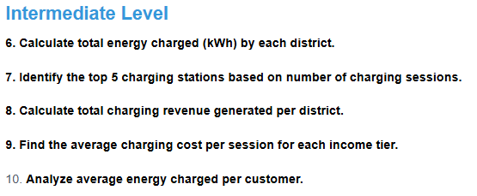
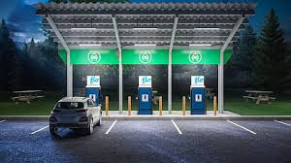
HIGH BATTERY COSTS
LIMITED INFRASTRUCTURE
PRODUCTION IMPACT
RANGE ANXIETY
WHAT TO DO!

Slide 9
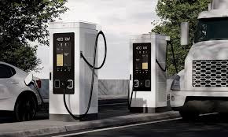
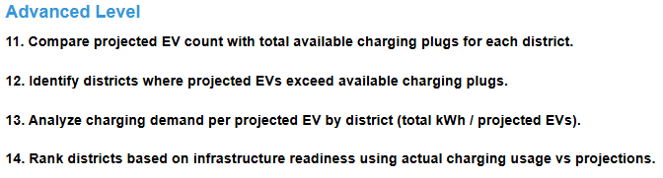
HIGH BATTERY COSTS
LIMITED INFRASTRUCTURE
PRODUCTION IMPACT
RANGE ANXIETY
WHAT TO DO!

Slide 10





Slide 11
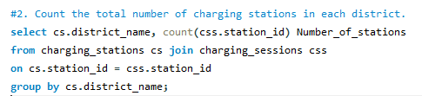
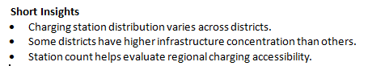



Slide 12

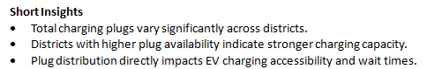
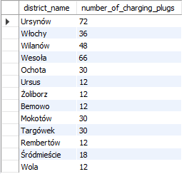


Slide 13

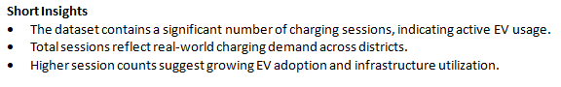



Slide 14

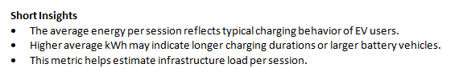

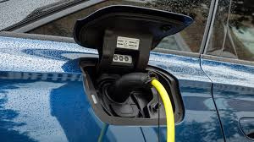

Slide 15
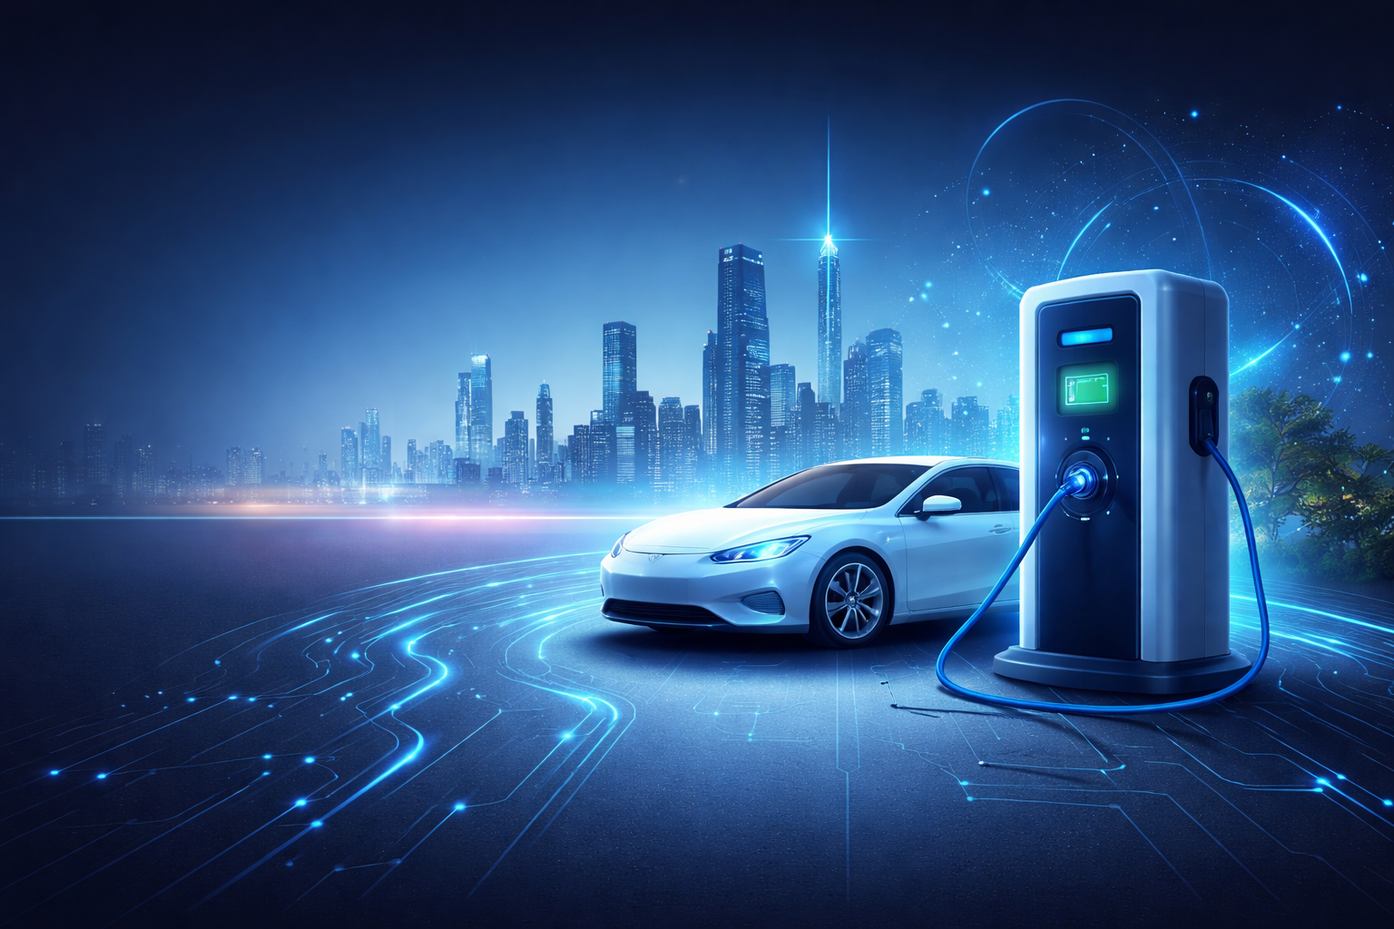
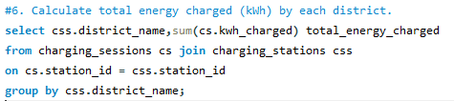

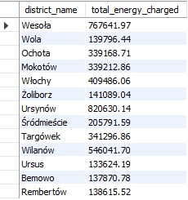

Slide 16
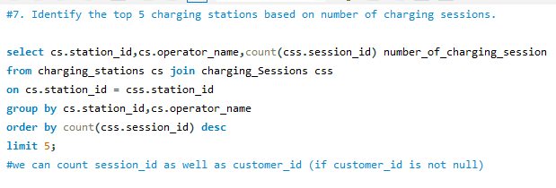



Slide 17
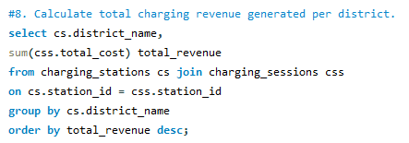

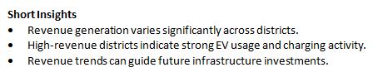

Slide 18




Slide 19

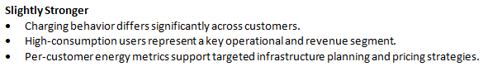
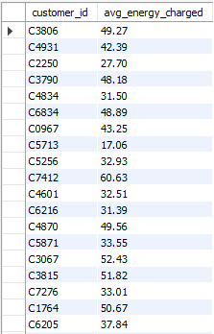
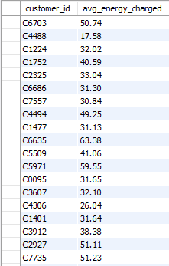

Slide 20

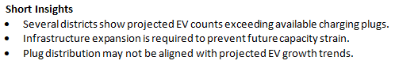
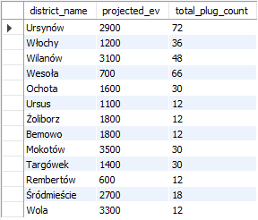

Slide 21
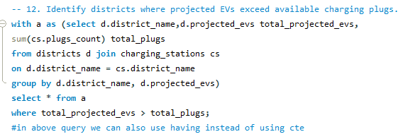
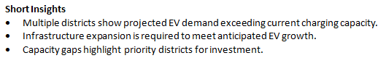
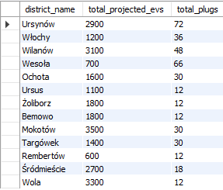

Slide 22
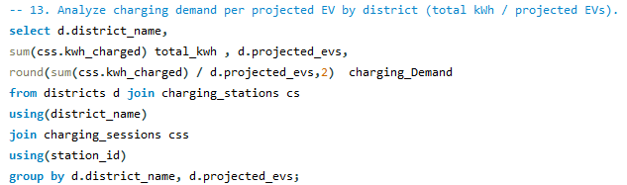
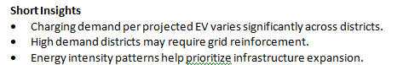
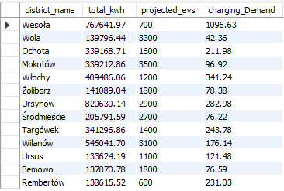

Slide 23
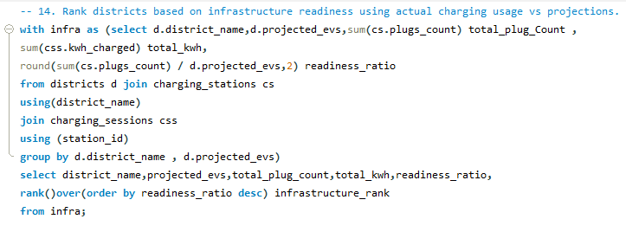
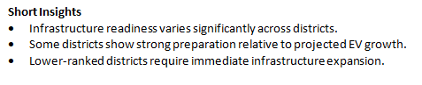
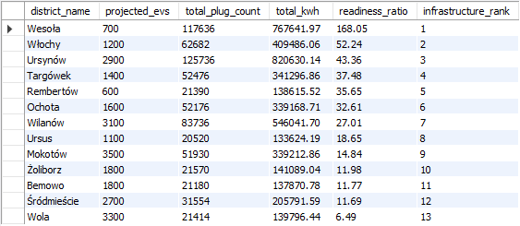

Slide 24





SALFORD & CO.
HOME
ABOUT US
SERVICES
TEST DRIVE
CONTACT
THANK YOU
+123-456-7890
www.reallygreatsite.com
hello@reallygreatsite.com
123 Anywhere St., Any City, ST 12345

